Slide 1
R package building
Chen Hao
29 Sep 2014

Slide 2
Why packages? R is mostly packages!
R ships with 13 base packages, and 15 recommended packages.
CRAN contains about 5000 packages, Bioconductor has about 1600.
There are other repositories (R-forge, Omegahat, rforge.net, etc.) and packages not in these repositories.
Notes:
What is in a package?
A package bundles together code, data, documentation and tests, and it’s easy to share with others.
Permanent R objects: functions, data, etc.
Help pages and vignettes documenting these objects.
External code in C, C++, Fortran, Objective C, etc. to implement some of the functions, or link to external libraries or programs.
Tests to help to keep the code working as R evolves.

Slide 3
The Structure of a R package
pkgName (the name of your package)
|
|----DESCRIPTION
|---- NAMESPACE
|---- R (R source codes)
|---- function1.R
|---- function2.R
|---- ...
|---- man (help documentss)
|---- function1.Rd
|---- function2.Rd
|---- ...
|---- vignettes
|---- data (rda data)
|---- demo (demo R codes)
|---- src (code of other language)
|---- inst (will remain in the root dir of the pkg)
|---- doc (store the vignettes )
Notes:
most commonly used components:
R/: where your R code lives in .R files
DESCRIPTION: metadata about the package
man/: function documentation
vignettes/: long-form documentation which show how to combine multiple parts of your package to solve real problems.
NAMESPACE: ensures that your package plays nicely with other packages.
tests/: stores unit tests that ensure that your package is operating as designed.
data/: sample datasets (or other R objects)
src/: compiled C, C++ and Fortran source code

Slide 4
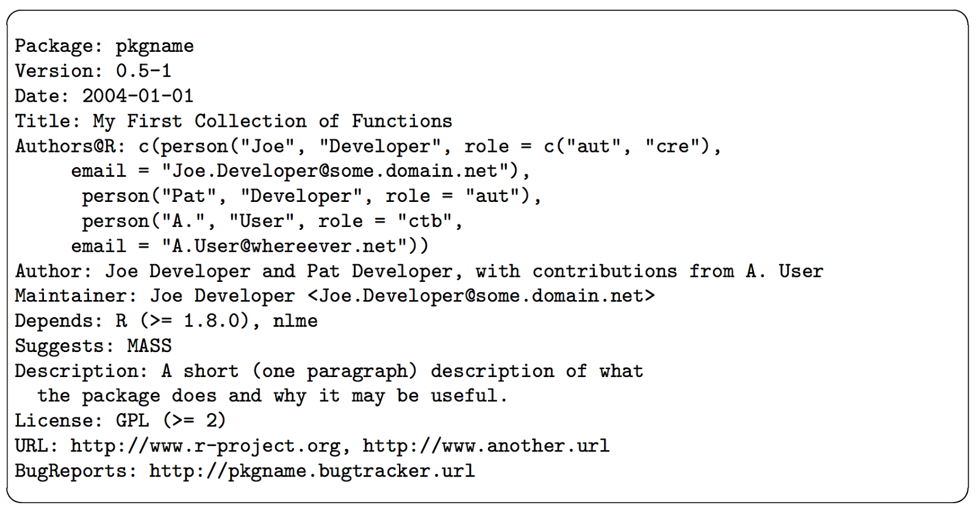
DESCRIPTION
Notes:
Every package must have a DESCRIPTION. In fact, it’s the defining feature of a package. DESCRIPTION uses a simple file format called DCF, the Debian control format. You can see most of the structure in the simple example below. Each line consists of a field name and a value, separated by a colon. When values span multiple lines, they need to be indented.
The ‘Package’, ‘Version’, ‘License’, ‘Description’, ‘Title’, ‘Author’, and ‘Maintainer’ fields are mandatory, all other fields are optional. Fields ‘Author’ and ‘Maintainer’ can be auto-generated from ‘Authors@R’, and may be omitted if the latter is provided
The mandatory ‘Package’ field gives the name of the package. This should contain only (ASCII) letters, numbers and dot, have at least two characters and start with a letter and not end in a dot.
The mandatory ‘Version’ field gives the version of the package. This is a sequence of at least two (and usually three) non-negative integers separated by single ‘.’ or ‘-’ characters. The canonical form is as shown in the example, and a version such as ‘0.01’ or ‘0.01.0’ will be handled as if it were ‘0.1-0’. It is not a decimal number, so for example 0.9 < 0.75 since 9 < 75.
The mandatory ‘License’ field is discussed in the next subsection.
The mandatory ‘Description’ field should give a comprehensive description of what the package does. One can use several (complete) sentences, but only one paragraph.
The mandatory ‘Title’ field should give a short description of the package. Some package listings may truncate the title to 65 characters. It should be capitalized, not use any markup, not have any continuation lines, and not end in a period.
The mandatory ‘Author’ field describes who wrote the package. It is a plain text field intended for human readers, but not for automatic processing (such as extracting the email addresses of all listed contributors: for that use ‘Authors@R’). Note that all significant contributors must be included: if you wrote an R wrapper for the work of others included in the src directory, you are not the sole (and maybe not even the main) author.
The mandatory ‘Maintainer’ field should give a single name followed a valid (RFC 2822) email address in angle brackets. It should not end in a period or comma. This field is what is reported by the maintainer function and used by bug.report. For a CRAN package it should be a person, not a mailing list and not a corporate entity: do ensure that it is valid and will remain valid for the lifetime of the package.
The ‘Depends’ field gives a comma-separated list of package names which this package depends on. Those packages will be attached before the current package when library or require is called. Each package name may be optionally followed by a comment in parentheses specifying a version requirement.

Slide 5
R/
While it’s free to arrange functions into files as you wish, the two extremes are bad:
don’t put all functions into one file
don’t put each function into its own separate file.
One big difference between a script and a package is that the code in a package should not have side effects. Your code should only create objects (mostly functions), and you should not call functions that affect the global state:
Don’t use library() or require(). Use the DESCRIPTION to specify you package’s requirements.
Don’t modify global options() or graphics par(). Put state changing operations in functions that the user can call when they want.
Don’t save files to disk with write(), write.csv(), or saveRDS(). Use data/ to cache important data files.
Notes:
While you’re free to arrange functions into files as you wish, the two extremes are bad: don’t put all functions into one file and don’t put each function into its own separate file.
you can’t use subdirectories inside in R/.

Slide 6
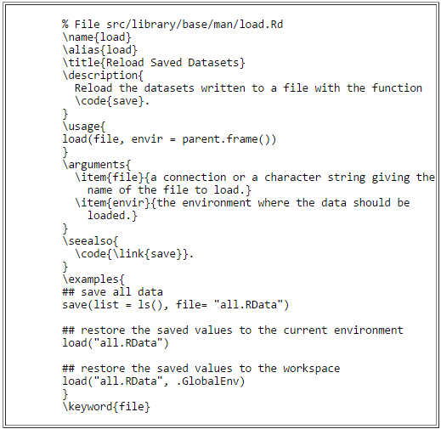
man/ -- R Documents
Notes:
Documentation
these files use a custom syntax, loosely based on LaTeX, and are rendered to HTML for viewing.

Slide 7
NAMESPACE
As the name suggests, namespaces provide “spaces” for “names”. They provide a context for looking up the value of an object associated with a name. In package development, namespaces help your packages be self contained in two ways:
The namespace imports defines how a function in a package finds a function in another package. It controls which external functions can be used by your package without qualification with :: .
Namespaces also help your package avoid conflicts with other packages through the exports. The exports control which functions are available outside of your package. Internal functions are available only within your package - they can’t (easily) be used from another package. Exported functions must be documented, and you must be cautious when changing their interface — other people are using them
Notes:
NAMESPACE is not that important if you are only developing packages for yourself. However, understanding namespaces is vital if you plan to submit your package to CRAN because they ensure that your package plays well with others.

Slide 8
You can see that the NAMESPACE file looks a bit like R code. Each line contains a directive
In total, there are eight namespace directives. Four describe exports:
export(): export functions (including S3 and S4 generics).
exportPattern(): export all functions that match a pattern.
exportClasses(), exportMethods(): export S4 classes and methods.
S3method(): export S3 methods.
And four describe imports:
import(): import all functions from a package.
importFrom(): import selected functions.
importClassesFrom(), importMethodsFrom(): import S4 classes and methods.
useDynLib(): import a function from C. This is described in more detail in compiled code.

Slide 9
Difference between NAMESPACE and DESCRIPTION
If you are using just a few functions from another package, the recommended option is to note the package name in theImports: field of the DESCRIPTION file and call the function(s) explicitly using ::, e.g., pkg::fun().
If you are using functions repeatedly, you can avoid the :: by importing the function with @importFrom pgk fun. This also has a small performance benefit, because :: adds approximately 5 µs to function evaluation time.
Alternatively, if you are repeatedly using many functions from another package, you can import them in one command with @import package. This is the least recommended solution: it makes your code harder to read (because you can’t tell where a function is coming from), and if you @import many packages, the chance of a conflicting function names increases.
Notes:
The NAMESPACE also controls which external functions can be used by your package without qualification with ::.
It’s confusing that both DESCRIPTION (through the Import field) and the NAMESPACE (through import directives) seem to be involved in imports. Unfortunately this is just a naming confusion. The Import field really has nothing to do with imports: it just makes sure the package is installed and loaded when your package is. It doesn’t make any functions available without qualification. You need to import functions in exactly the same way regardless of whether or not the package is loaded.
Depends is just a user convenience: if your package is attached, it also attaches all packages listed in Depends. If your package is loaded, packages in Depends are loaded, but not attached, so you need to quality function names with :: or specifically import them.
It is common for packages to be listed in Imports the DESCRIPTION, but not in the NAMESPACE. In fact, this is the default I recommend: list the package in DESCRIPTION so that it’s installed, then always refer to it explicitly with pkg::fun(). Unless there is a strong reason otherwise, it’s better to be explicit. It’s a little more work to write, but a lot easier to read when you come back to the code in the future. The converse is not true. Every package mentioned in NAMESPACE must also be present the the Imports or Depends fields.

Slide 10
src/
It’s often useful to include compiled code in an R package. Compiled code, whether it’s C, C++ or Fortran, is a powerful complement to R code.
在src目录下我们可以放置一些其它语言的源代码，里面可能包含一些函数，这些函数在被编译之后，（以C语言为例）可以在R代码中以.C('routine_name', ..., package = 'pkg')的形式调用，但要注意，如果需要用这个功能，在R目录下需要有一个zzz.R文件（这个特殊文件是用来在加载包之前加载运行的代码），里面写上：
.onLoad <- function(lib, pkg) { library.dynam("pkg_name", pkg, lib) # pkg_name是你的包的名字 }

Slide 11
Data/
It’s often useful to include data in a package. If you’re releasing the package to a broad audience, an interesting dataset is useful for building compelling examples.
The most common location for package data is (surprise!) data/. Each file in this directory should be a .rdata file created by save() containing a single object (with the same name as the file). If the DESCRIPTION contains LazyData: true, then datasets will be lazily loaded. This means that they don’t occupy any memory until you use them.
The easiest way to adhere to these rules is to use devtools::use_data()`:
x <- sample(1000) devtools::use_data(x, mtcars)
Notes:
There are three ways to include data in your package, depending on what you want to do with it and who should be able to use it:
If you want to store parsed data, and make it available to the user, put it in data/. This is the best place to put example datasets.
If you want to store parsed data, but not make it available to the user, put it all R/sysdata.rda. This is the best place to put data that your functions need.
If you want to store raw data, put it in inst/extdata.
Objects in data/ are always effectively exported (they use a slightly different mechanism to the NAMESPACE but the details are not important). This means that the must be documented. Documenting data is like documenting a function with a few minor differences. Instead of documenting the data directly, you document the name of the dataset.

Slide 12
Internal data
Sometimes functions need pre-computed data tables. If you put these in data/ they’ll also be available to package users, which is not appropriate. Instead, you can save them in R/sysdata.rda. For example, two coloured related packages, munsell and dichromat, use R/sysdata.rda to store large tables of colour data.
You can use devtools::use_data() to create this file with the argument internal = TRUE:
x <- sample(1000) devtools::use_data(x, mtcars, internal = TRUE)
Again, it’s a good idea to make the code used to generate this file reproducible. Put it in data-raw/.
Objects in R/sysdata.rda are not exported (and shouldn’t be), so don’t need to be documented. They’re only available inside your package.
Raw data
If you want to show examples of loading/parsing raw data, put the original files in inst/extdata. When the package is installed, all files in inst/ are moved into the top-level directory (so they can’t have names like R/ or DESCRIPTION). To refer to files in inst/extdata (whether installed or not), use system.file():
system.file("include", "Rcpp.h", package = "Rcpp")#> [1] "/usr/lib/R/site-library/Rcpp/include/Rcpp.h"
Beware: if the file does not exist, system.file() does not return an error - it just returns the empty string:
system.file("include", "Rcp.h", package = "Rcpp")#> [1] ""
Notes:
Other data
Data for tests: it’s ok to put small files directly in your tests directory. But remember unit tests are for testing correctness, not performance, so keep the size small.
Data for vignettes. Data should either go in data/ if you want to show how to work with an already loaded dataset, or in inst/extdata if you want to show how to load raw data.

Slide 13
vignettes/
Vignettes are documentation in R packages that may include R code. The code is run when the vignette is “woven”, and the code can be extracted when the vignette is “tangled”. The vignette source is in the vignettes directory of the package.
Vignettes are considered to be part of R’s help system. The help system will display their title, and links to the PDF, source, and extracted R code. This is based on some special “meta-data” included in the source.
They are the best way to present an overall introduction to a package.
They can give technical details about how a package was implemented.
They can demonstrate particular aspects of the package.
Once happy with the report, you can use devtools::build_vignettes() to generate the vignette files that will be copied to the relevant locations(inst/doc: the output vignette)
Notes:
For packages hosted by CRAN, vignettes are an optional component. However, the Bioconductor project requires that vignettes be included in each package.
Prior to R 3.0, one generally had to write vignettes using sweave, a combination of latex and R code that generates a PDF file. However, since v3.0, it is possible to write vignettes using R markdown (and actually some other markup formats), which generates HTML output. The advantages to using R markdown over sweave are that the syntax for writing markdowns much simpler, and much more readable in it's raw format.

Slide 14
Any tools to make this automatically
Traditional way
可以用package.skeleton() 生成pkg骨架
Never use package.skeleton() to create a package. It’s designed for an older era of package development, and mostly serves to make your life harder, not easier.
或者prompt()等函数来辅助生成Rd文件
若你的包只有一两个函数，倒也无妨，轻松写写完事，要是你想维护30个函数，那你就会觉得这种做法完全是坑爹。坑爹之处不仅在于你要么手敲这些命令要么绕道用函数生成文档模板自己填充，更在于你得在man文件夹下维护R文件夹下的函数的文档！你每次更新R函数，都得战战兢兢记住了：还有man文件夹下的某个*.Rd文件也许需要更新。
Notes:
The most accurate resource for up-to-date details on package development is always the official writing R extensionsguide. However, it’s rather hard to understand if you’re not already familiar with the basics of packages. It’s also exhaustive, covering every possible package component, rather than focussing on the most common and useful components as this book does. Writing R extensions is a useful resource once you’ve mastered the basics and need to check on more esoteric facts.
Developing packages with devtools may take some getting used to. However, I strongly believe that the time invested in mastering it will, in the long run, save you much, much more time. Devtools is a key component of my productivity in package development.
Devtools works hand-in-hand with RStudio, which I believe is the best development environment for most R users. The only real competitor is ESS, emacs speaks statistics, which is a rewarding environment if you’re willing to put in the time to learn emacs and customise it to your needs.

Slide 15
Rstudio and devtools
Philosophy of package development:
anything that can be automated, should be automated. Do as little as possible by hand.
--- Hadley Wickham

Slide 16
Requirements for building your package
To get started, make sure you have the latest version of R (at least 3.1.0, which was current when I wrote this book), then run the following code to get the packages you’ll need:
install.packages(c("devtools", "roxygen2", "testthat", "knitr"))
You’ll also need to make sure you have a C compiler and other needed command line tools. If you’re on Windows or Mac and you don’t already have them, RStudio will install them for you. Otherwise:
On Windows, download and install Rtools. NB: this is not an R package!
On Mac, make sure you have either XCode (available for free in the App Store) or the “Command Line Tools for Xcode”. NB: you’ll need to have an Apple ID (available for free).
On Linux, make sure you’ve installed not only R, but the R development devtools. This is a Linux package called something like r-base-dev.

Slide 17
Getting started
The easiest way to get started with a package is to run:
install.packages('devtools',dependencies=T)
devtools::create("path/to/package/pkgname")
This makes the package directory, path/to/package/pkgname/, and adds four items to make the smallest usable package:
An RStudio project file, pkgname.Rproj.
An R/ directory.
A basic DESCRIPTION file.
A basic NAMESPACE file.
Notes:
To get started with your new package in RStudio, double-click the package.Rproj file that create() just made. This will open a new RStudio project for your package. Projects are a great way to develop packages.
The first advantage of using a package is that it’s easy to re-load your code. There are two main options:
devtools::load_all(), Cmd + Shift + L, reloads all code in the package. In RStudio, this also saves all open files, saving you a keystroke.
Build & reload, Cmd + Shift + B. This is only available in RStudio. It installs the package, restarts R, and then reloads the package with library() (doing this by hand is painful).
These commands make your development workflow more fluid:
Edit R files in the editor.
Press Cmd + Shift + L (or Cmd + Shift + B).
Explore the code in the console.
Rinse and repeat.

Slide 18
Build the package
Four types of packages:
Source -- the development version of a package that lives on your computer.
Bundled -- a package compressed into a single file. By convention, package bundles in R use the extension.tar.gz. This convention comes from Linux: it means that multiple files have been collapsed into a single file (.tar) and then compressed using gzip (.gz). Call devtools::build() to make a package bundle.
Binary -- Binary packages are platform specific: you can’t install a Windows binary package on a Mac or vice versa. Also, Mac binary packages end in .tgz and Windows binary packages end in .zip. You can use devtools::build(binary = TRUE)to make a binary package.
Installed -- An installed package is just a binary package that’s been decompressed into a package library.

Slide 19
Generating Rd files using Roxygen comments
#' title(one line)
#'
#' description (one paragraph)
#'
#' details here (any length you want)
#'
#' @param a
#' @param b
#' @return
#' @author abc <\url{http://abc.com}>
#' @examples
myFunction <- function(a, b){
return(a + b)
}
As well as generating `.Rd` files, `roxygen2` can also manage your `NAMESPACE` and the Collate field in `DESCRIPTION`. To do this, only two simple steps:
Add roxygen comments to your `.R` files.
Run devtools::document() on the R console (or press `Cmd + Shift + D` in RStudio) to convert roxygen comments to `.Rd` files.
Notes:
Documentation always seemed like the most intimidating step to me. I’m here to tell you — it’s super quick. The package roxygen2 that makes everything amazing and simple. The way it works is that you add special comments to the beginning of each function, that will later be compiled into the correct format for package documentation.
As well as generating `.Rd` files, `roxygen2` can also manage your `NAMESPACE` and the Collate field in `DESCRIPTION`. To do this, only two simple steps:
1. Add roxygen comments to your `.R` files. (as the example above)
2. Run `devtools::document()` on the R console (or press `Cmd + Shift + D` in RStudio) to convert roxygen comments to `.Rd` files.

Slide 20
Documenting datasets
Objects in data/ are always effectively exported (they use a slightly different mechanism to the NAMESPACE but the details are not important). This means that the must be documented. Documenting data is like documenting a function with a few minor differences. Instead of documenting the data directly, you document the name of the dataset. For example, the roxygen2 block used to document the diamonds data in ggplot2 looks something like this:
#' Prices of 50,000 round cut diamonds.
#‘
#' A dataset containing the prices and other attributes of almost 54,000
#' diamonds.
#‘
#' @format A data frame with 53940 rows and 10 variables:
#' \describe{#' \item{price}{price, in US dollars}
#' \item{carat}{weight of the diamond, in carats}
#' ...
#' }
#' @source \url{http://www.diamondse.info/}
"diamonds"
Notes:
There are two additional tags that are important for documenting datasets:
@format, which gives an overview of the dataset. For data frames, you should include a definition list that describes each variable. It’s usually a good idea to describe units here.
@source where you got the data form, often a \url{}.
Never @export a data set.

Slide 21
Vignette with markdown
A vignettes is like a book chapter or an academic paper: it should describe the problem that you package is designed to solve, and then show the reader how to solve it. Vignettes should divide functions into useful categories, and demonstrate how to coordinate multiple functions to solve problems
Each vignette provides three things: the original source file, a readable html page or a pdf, and a file of R code. You can read a specific vignette with vignette(x), and see its code with edit(vignette(x)).
Before R 3.0.0, only way to create vignetes was with Sweave. This was painful because Sweave only worked with LaTeX, and LaTeX is both hard to learn and slow to compile. Now, any package can provide a vignette engine, a standard interface for turning input files into html or pdf vignettes. In this chapter, we’re going to use the R markdown vignette engine provided by knitr.
Currently, the easiest way to get R Markdown is to use RStudio. RStudio will automatically install all of the needed prerequisites. If you don’t use RStudio, you’ll need to:
Install the rmarkdown package with install.packages("rmarkdown").
Install pandoc.
Notes:
If you’ve never used markdown before, a good place to start is the Markdown syntax documentation, written by John Gruber, the author of the original markdown. Pandoc’s implementation of markdown cleans up a number of rough edges and adds a number of new features, so I also recommend familiarising yourself with the pandoc readme.

Slide 22

Vignette workflow
To create your first vignette, run:
devtools::use_vignette("my-vignette")
This will:
Create a vignettes/ directory.
Add the necessary dependencies to DESCRIPTION (i.e. it adds knitr to Suggests and VignetteBuilder fields).
Draft a vignette, vignettes/my-vignette.Rmd.
The draft vignette has been designed to remind you of the important parts of an R Markdown file, so it should be a useful reference when you’re creating a new vignette.
Once you have this file, the workflow is simple:
Modify the vignette.
Press Cmd + Shift + K (or click ) to knit the vignette and preview the output.
Notes:
You can build all vignettes from the console with devtools::build_vignettes(), but this is rarely useful. Instead usdevtools::build() to create a package bundle with the vignettes included.

Slide 23
There are three important components to an R Markdown vignette:
The initial metadata block.
Markdown for formatting text.
Knitr for intermingling text, code and results.
Metadata
The first few lines of the vignette contain important metadata. The default template contains the following information:
--- title: "Vignette Title" author: "Vignette Author" date: "` r Sys.Date()`" output: rmarkdown::html_vignette vignette: > %\VignetteIndexEntry{Vignette Title} %\VignetteEngine{knitr::rmarkdown} %\usepackage[utf8]{inputenc} ---
Notes:
This metadata is written in yaml, a format designed to be both human and computer readable. The basics of the syntax is much like the DESCRIPTION, each line consists of a field name, a colon, then the value of the field. The one special YAML feature we’re using here is >: that indicates the the following lines of text are plain text and shouldn’t use any special YAML features.
The fields are:
Title, author and date: the title of the vignette, author and date. You will want to fill these in yourself (or you can delete them if you don’t want the title block at the top of the page). The date is filled in by default: it uses a special knitr syntax (explained below) to insert today’s date.
Output: this tells rmarkdown what output format specification to use. There are many options that are useful for regular reports (including html, pdf, slideshows, …) but rmarkdown::html_vignette has been specifically designed to work well inside packages. See ?rmarkdown::html_vignette for more details.
Vignette: this contains a special block of metadata needed by R. You can see some of the history of vignettes here: originally all vignettes were written in LaTeX, so the metadata looks like LaTeX commands. You need to modifiy the \VignetteIndexEntry to provide the title of your vignette, as it will appear in the vignette index. Leave the other two lines as is. They tell R to use knitr to process this file, and that it’s encoded in UTF-8. (This is the only encoding you should ever write vingettes in.

Slide 24
Resources
Writing an R package from scratch a blog by Hilary Parker
http://hilaryparker.com/2014/04/29/writing-an-r-package-from-scratch/
R packages a book by Hadley Wickham
http://r-pkgs.had.co.nz/
writing R extensions official documents
http://cran.r-project.org/doc/manuals/R-exts.html#Creating-R-packages

